Slide 1
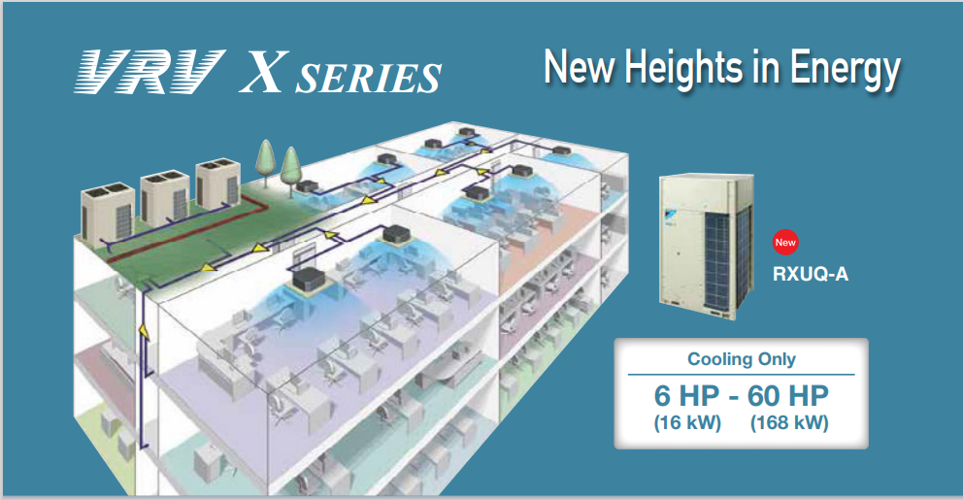

COMPANY PROFILE
Air Conditioning
The latest air conditioning technology manufactured by trusted brands and professionally installed for a comfortable working environment all year-round
VRV
VRV air conditioning and VRF air conditioning are innovative technologies that can simultaneously change temperatures in different rooms in a building
Ventilation
We are a professional Ventilation Services providing firm .

Slide 2
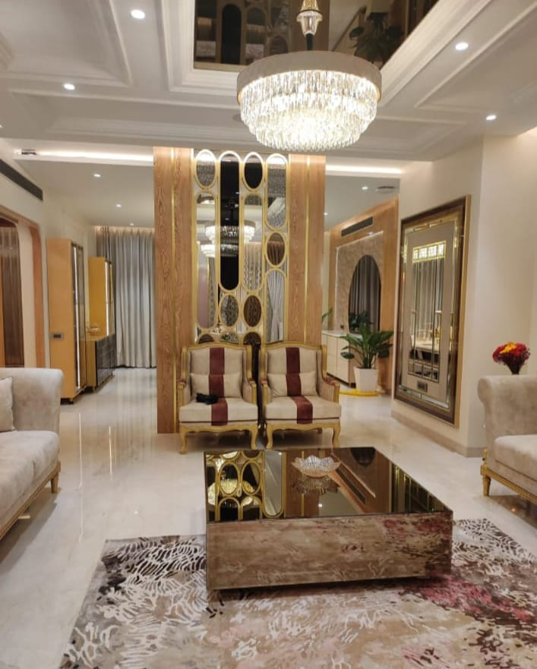

About Aero Heat And Cool Solutions PVT.LTD
Since 2025, we have provided Sale, services for installation and maintenance of ACs either residential or commercial. we take pride in the superior service that we provide to our customers and thus we have maintained a successful company by exceeding expectations on every job we perform to ensure repeat business. We are authorized dealer for Daikin brands. Our sales and service team have years of experience in this business and are able to provide fast, efficient and relevant information to handle your enquiries related to product information, pricing & availability. Our commitment to our clients reflects in the quality of work that we execute and the professional attitude of our staff guarantees a growing sense of trust & customer satisfaction. Today, we are on the journey of contributing towards the vision of Green Environment through our services & products that we offer.
OUR VISION
To be the most reliable, competitive & customer oriented sales and service provider for residential & commercial air conditioning systems.
OUR MISSION
Provide Competitive and effective solutions, products and services to our valuable clients. Seek growth through repeat & new business by providing prompt & efficient pre & post-sales services.

Slide 3
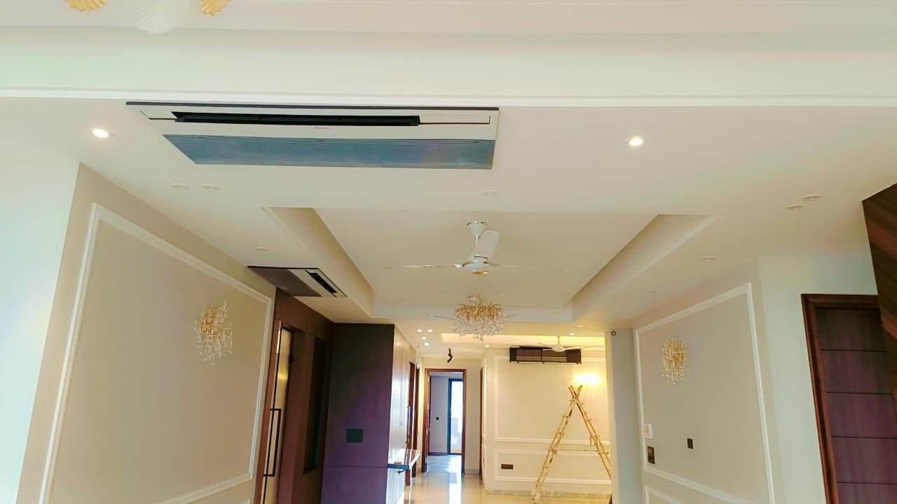
How Aero Heat and Cool Solutions Pvt.Ltd Projects can help your build :-
Just ask our clients and they will tell you that our expertise in HVAC installation and copper pipe installation is the best the industry can offer. There are no two projects the same, that’s why all of our installations are bespoke to compliment the interior design and practical requirements needed to run your business.
Aero Heat And Cool Solutions PVT.LTD has a solution for all your Air conditioning and ventilation requirements, delivering:
HVAC design and installation
Air-conditioning installation and maintenance
Copper Piping
Maintenance and service

Slide 4
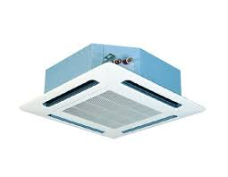
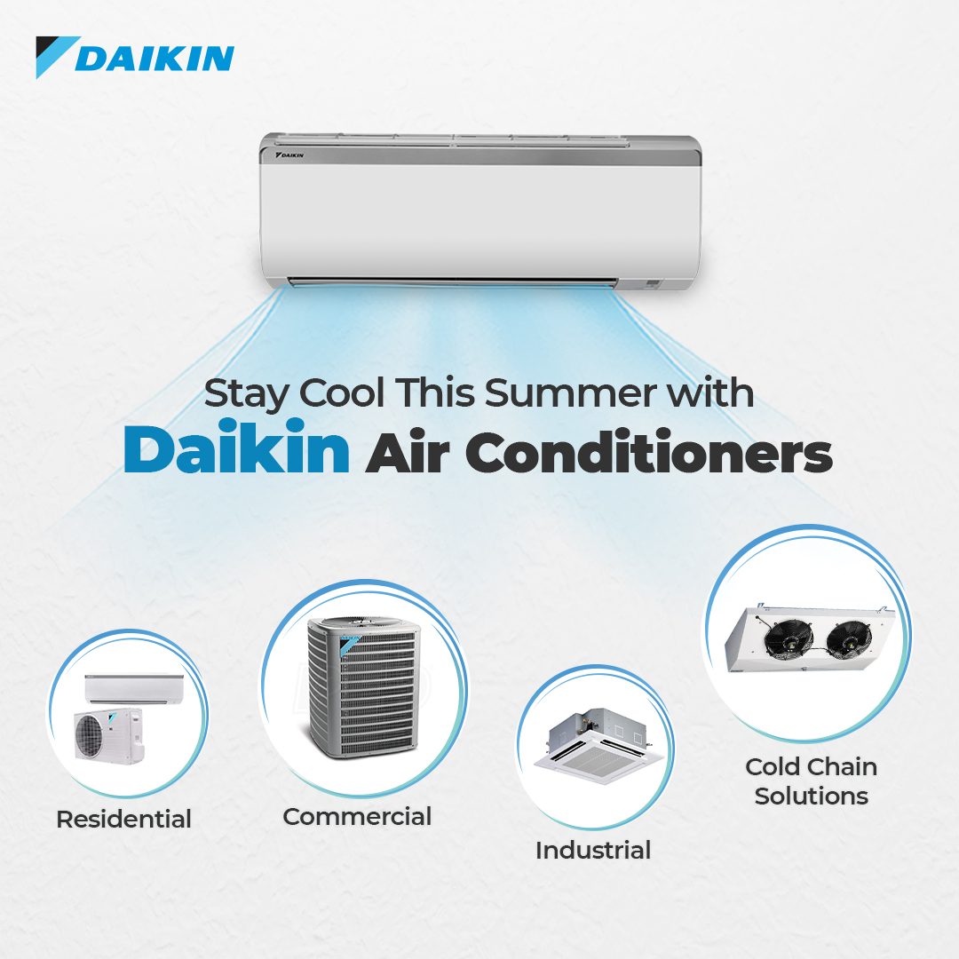
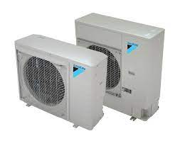
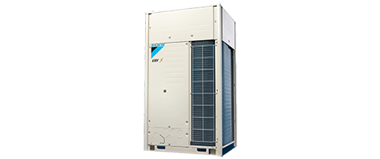

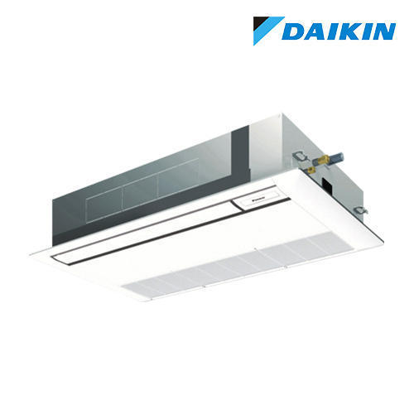
Air conditioning system
Outdoor Unit
Hi-Wall
4 Way Cassettes
One Way Cassettes AC
DX Ductable Ac
VRV ODU

Slide 5
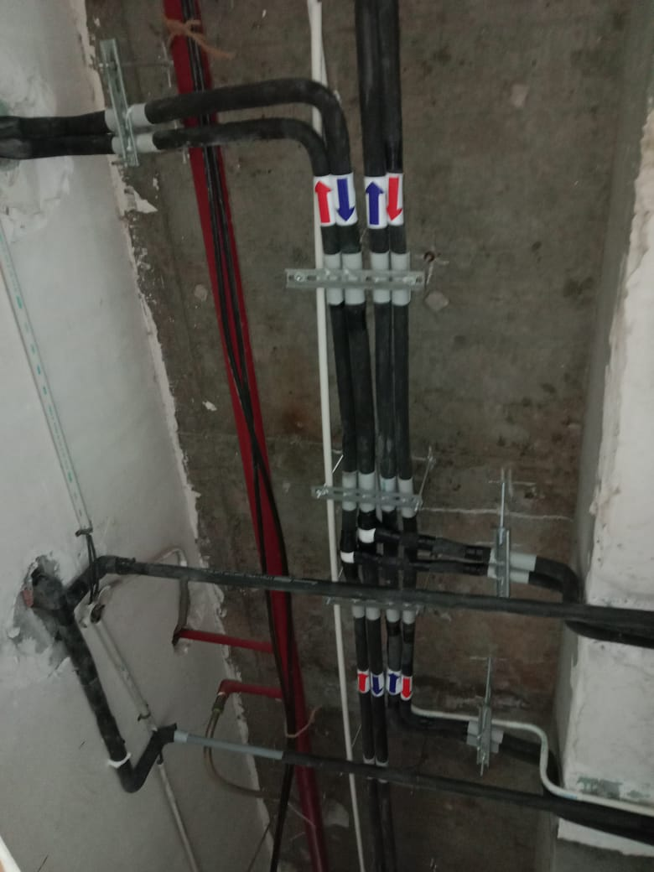
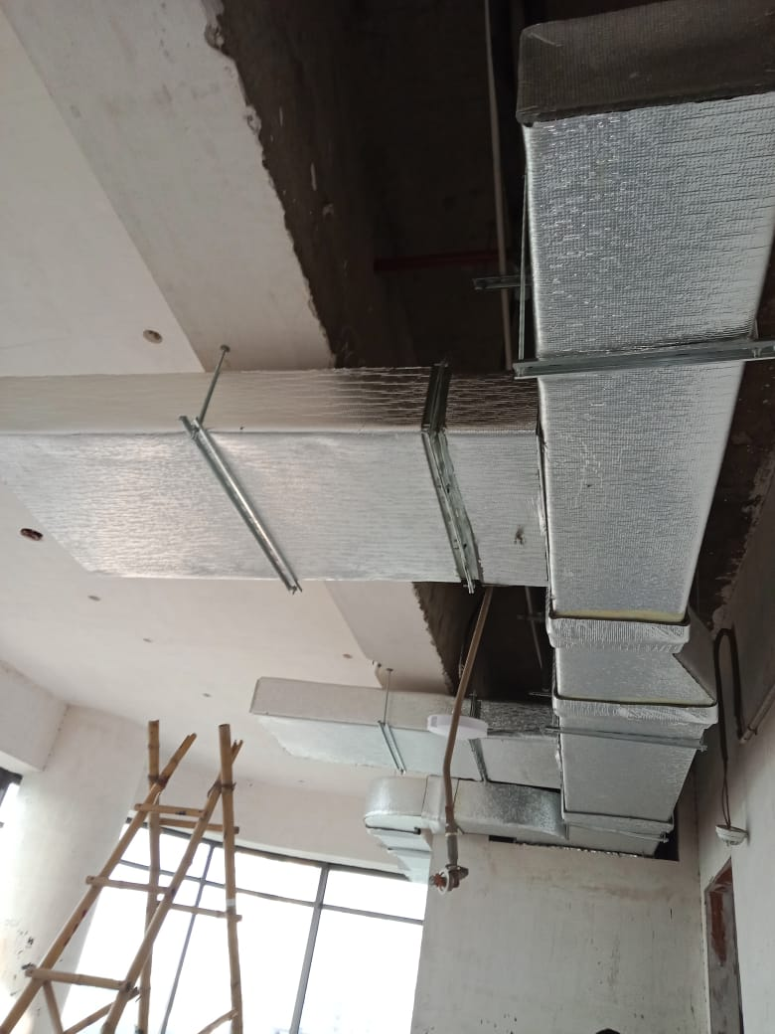
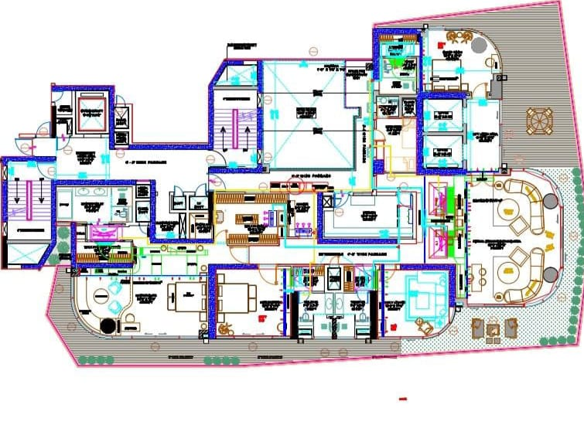
Air-conditioning Solutions & services
Copper Piping
We provide copper pipe installation for all air-conditioner for both residential & commercial complex for all sizes at very economical cost. Brand we use Mandev, Rajco, Maxflow.
Ducting GI ( Rectangular, Round ,Oval)
We Manufactured ducting in all shape & every size I.E 24 Gauge,22 & 18 with class finish insulation , we use G.I. sheet of TATA, Sail or Jindel, in insulation superlone. we have 25 Manpower for on site ducting fabrication.
Duct Designing in AUTOCAD
We have team of highly qualified designer for duct designing, we use technical method for designing the same as per air velocity in CFM/CMH

Slide 6
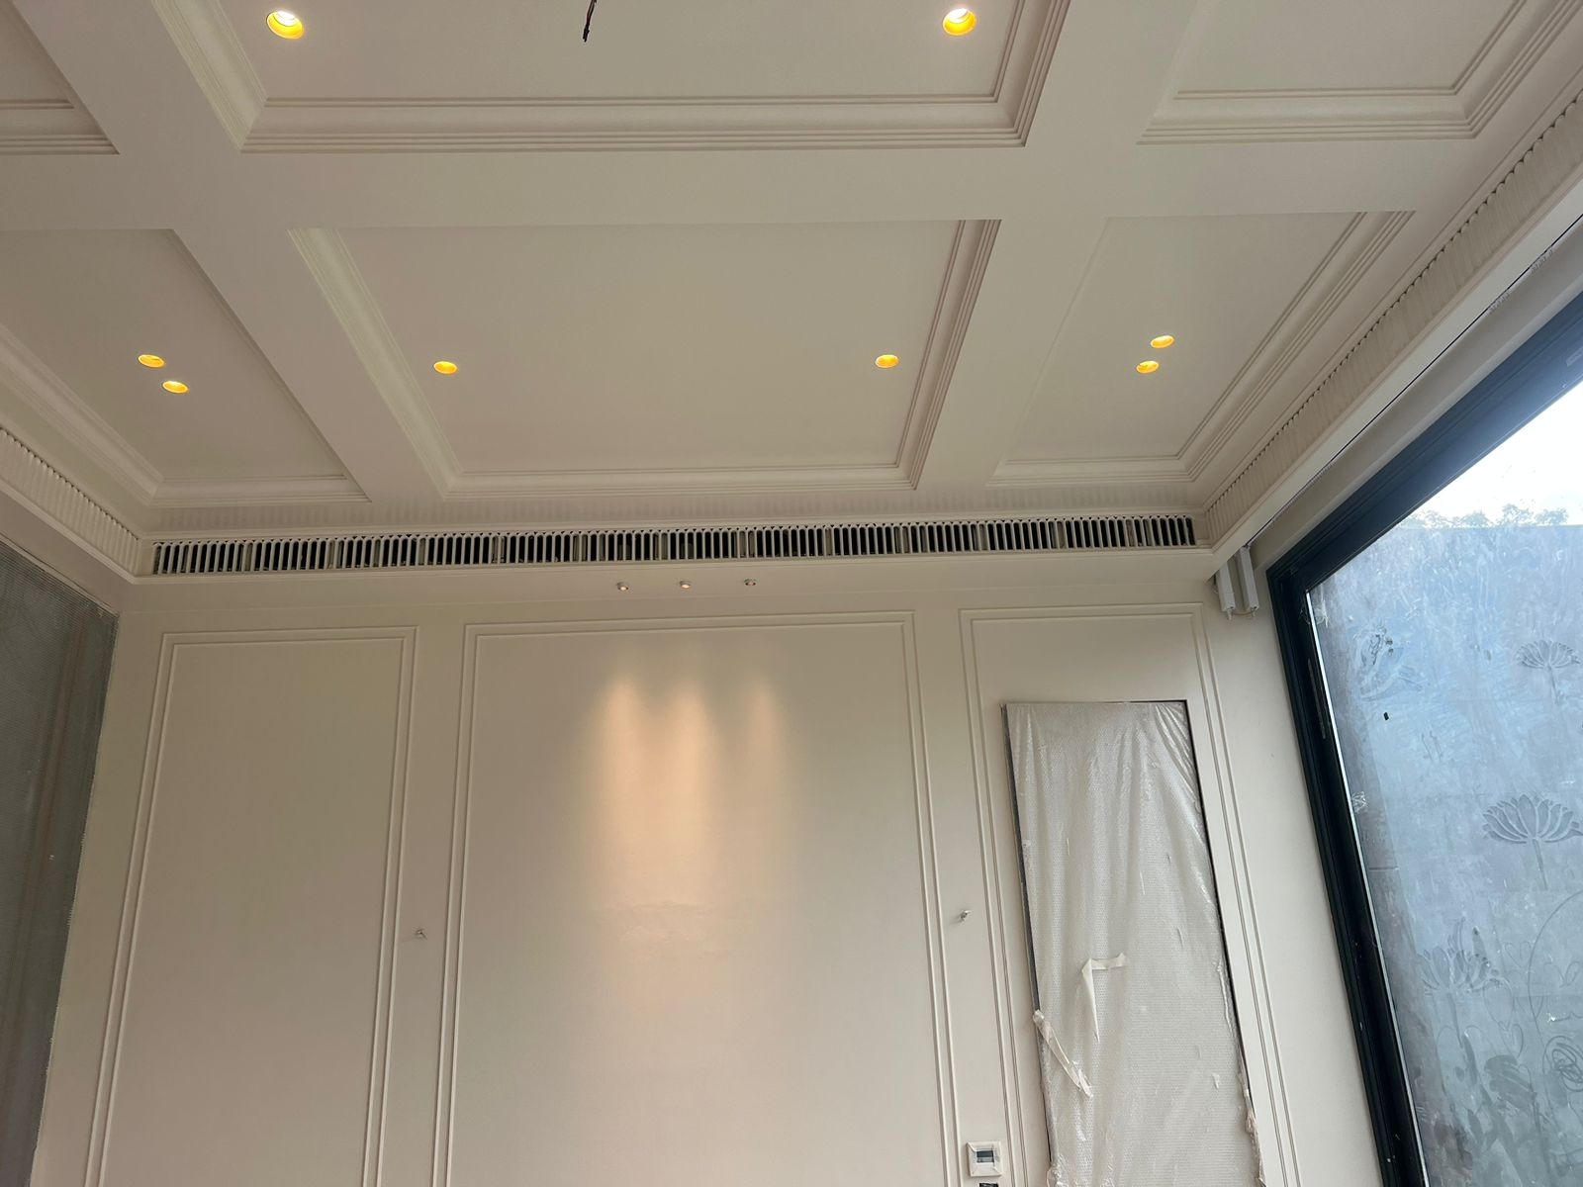
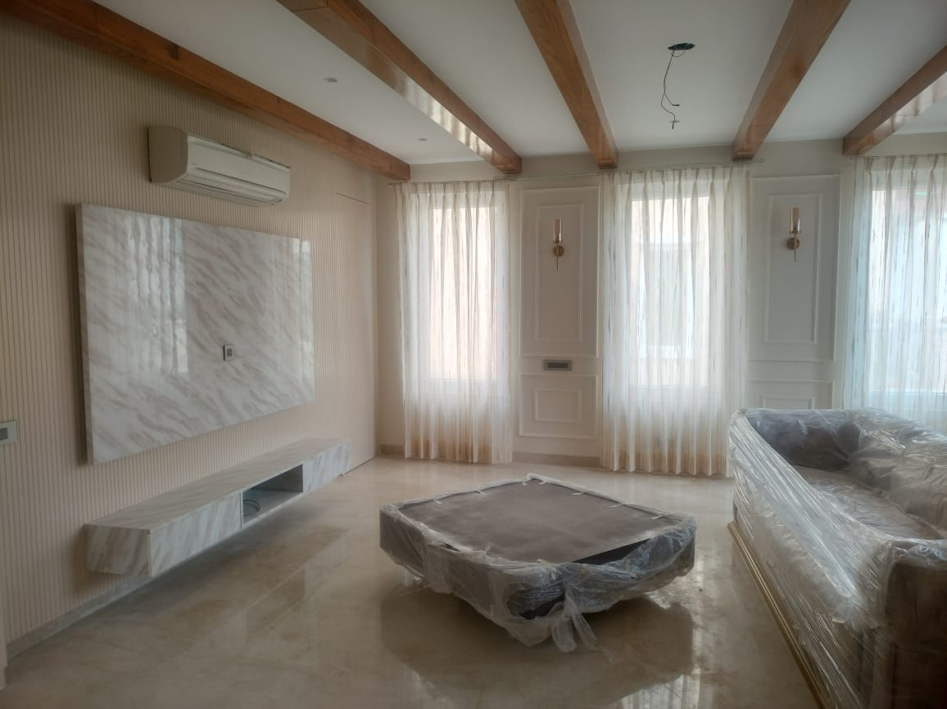
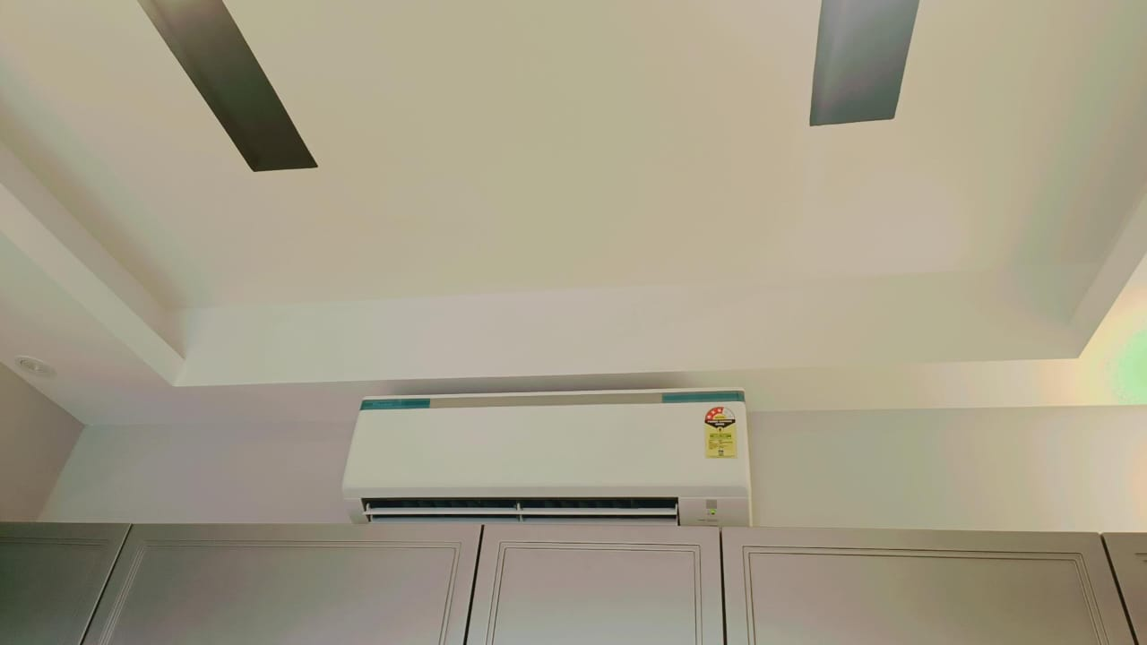
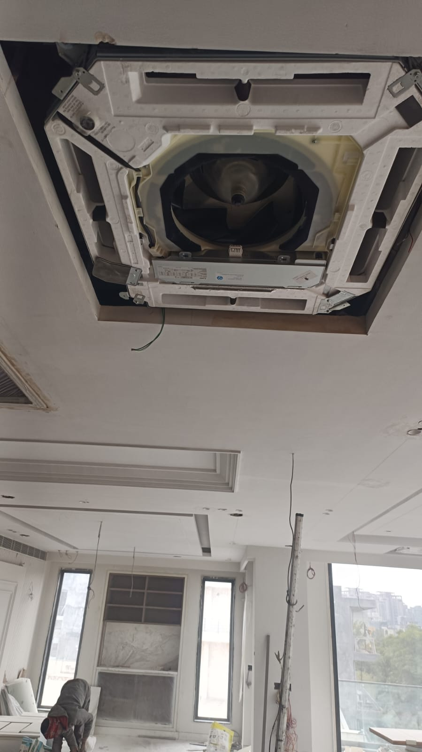
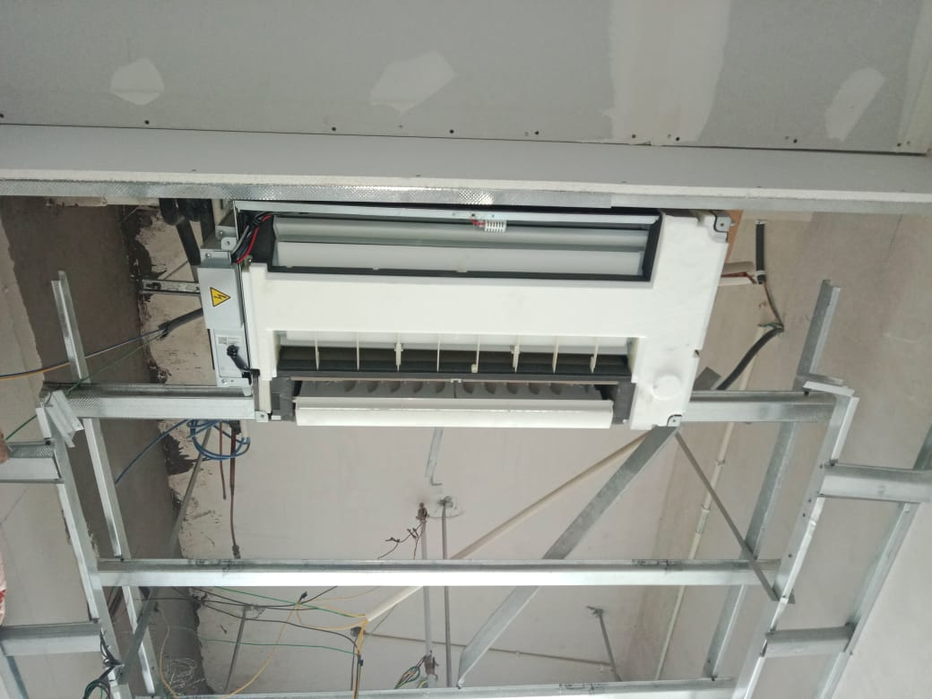
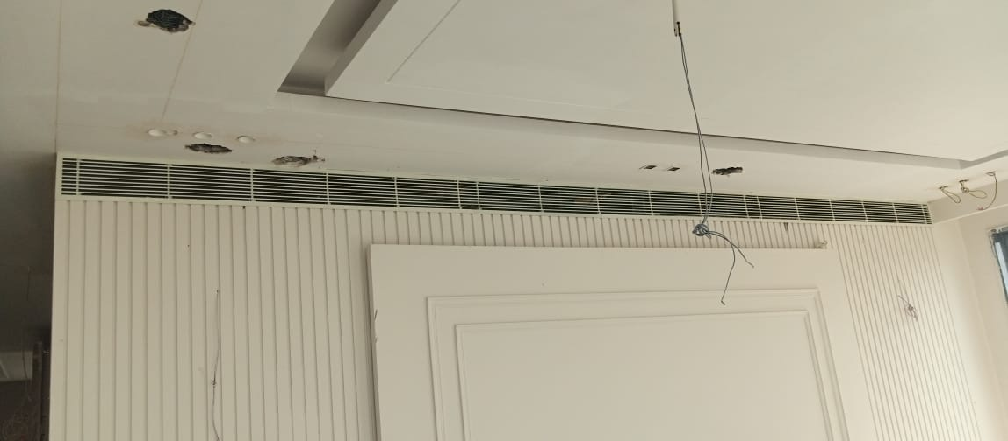
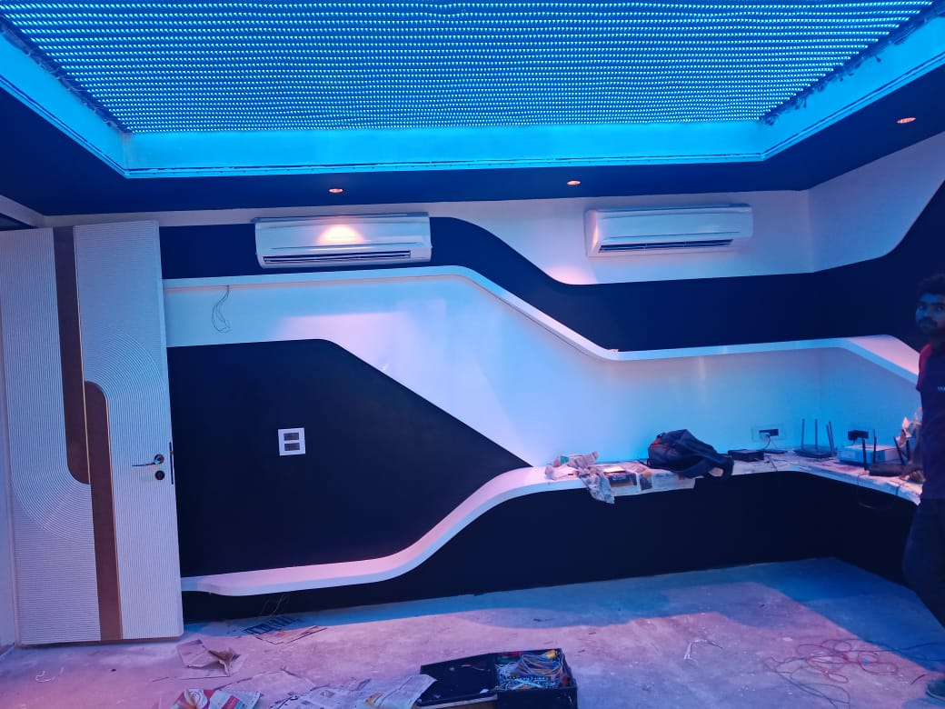
Installation of different air- condition technologies
Split Ac
Ductable Ac
VRV/VRF
Air-cooled /water cooled chiller
AIR Handling Unit ( AHU)

Slide 7
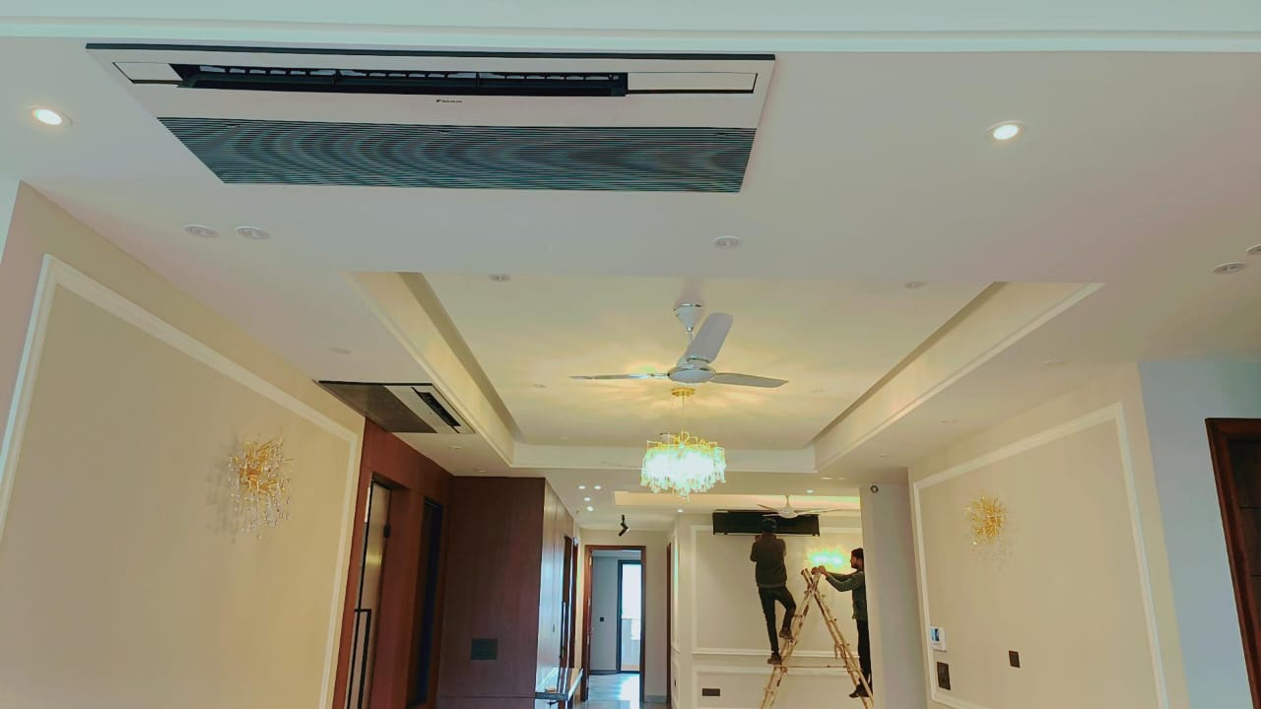
Air-conditioning AMC ( Annual Maintenance contract)
Our service range includes a wide range of AMC (Annual Maintenance Contract), AC Repair Service, AC Maintenance, AC Installation, 24/7 Technical Support and One Time Service.
It is a good idea to check your system before the cooling or heating seasons starts by one of your maintenance contractor.
Types of AMC
Ordinary Annual Maintenance Contract (OAMC) Comprehensive Annual Maintenance Contract (CAMC) With Compressor
Without Compressor - Compressor does not come under free repair/replacement.
Benifits & futures of contract 1. Any breakdown call will be attended with immediate response on normal working hours.
Systematic check of all elecrical parts compressor & fan motor etc.
Cleaning of air filter & unit.
Cleaning of cooling coil & condensor coil etc.
Oiling/Lubrication the fan motor.
Checking overall performance and current consumptions.
Details report of the A/C unit will be made and will be handover to customer for their reference.
Servicing Air Conditioners Unit will be on Monthly/Alternate Monthly and Quarterly Basis as per Customer desires.

Slide 8


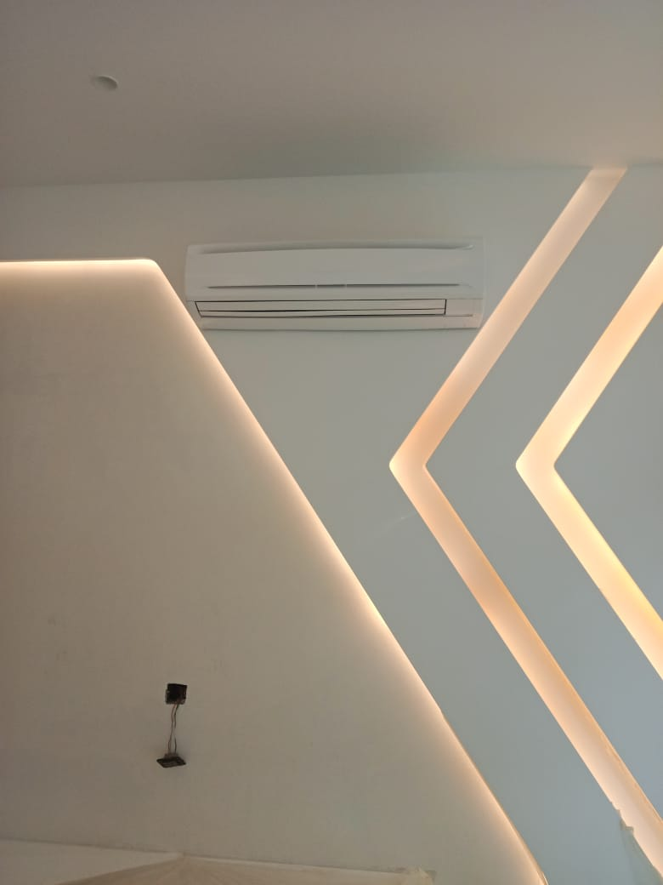
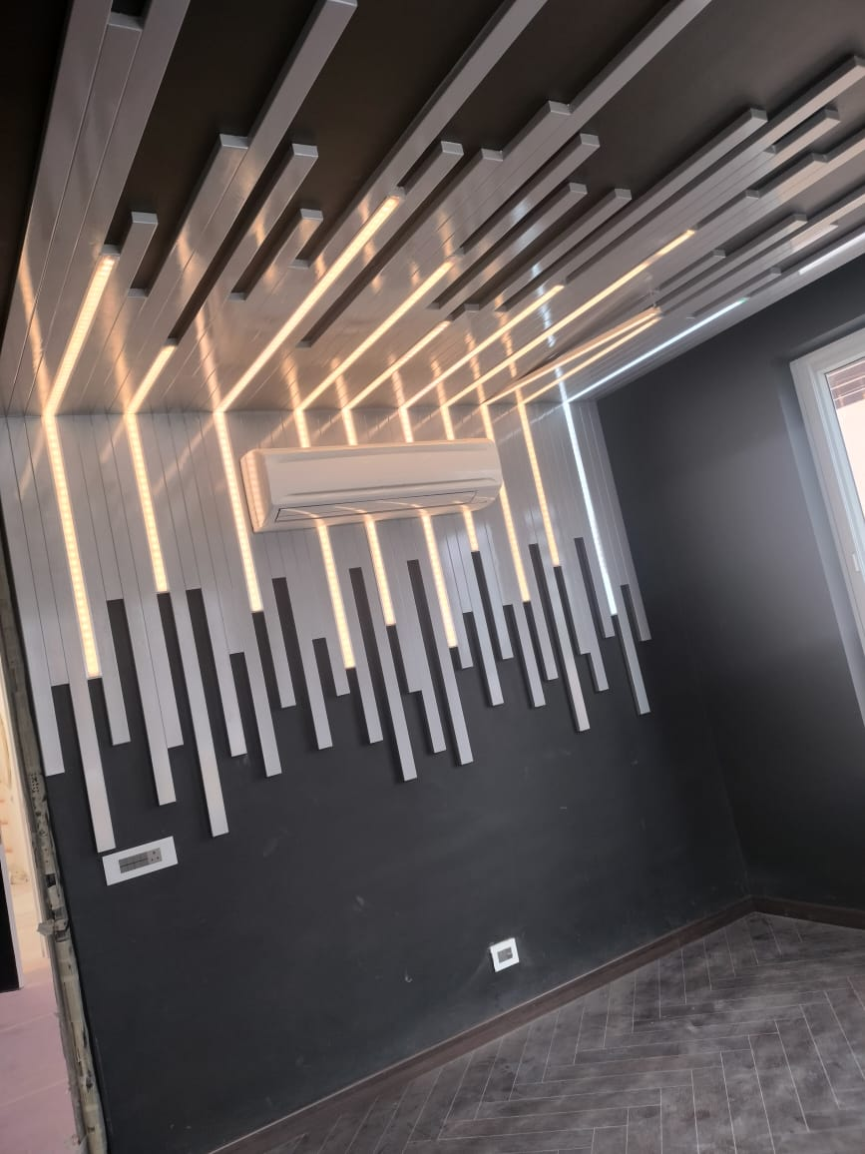
Brands we use

Slide 9
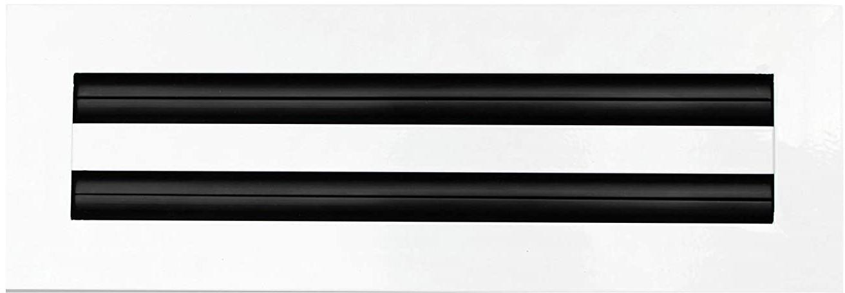
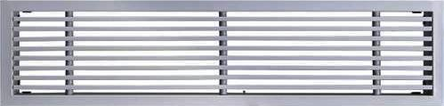

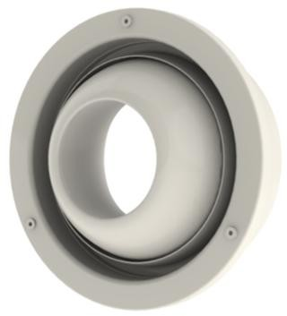
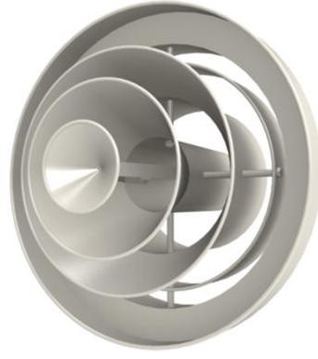
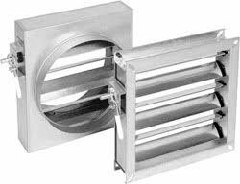
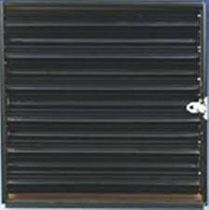
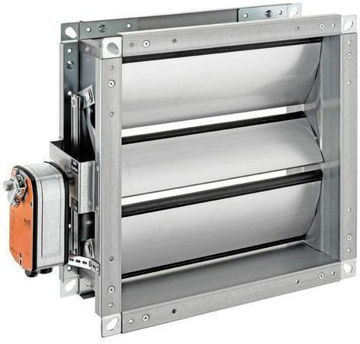
AIR DISTRIBUTION PRODUCTS

Slide 10
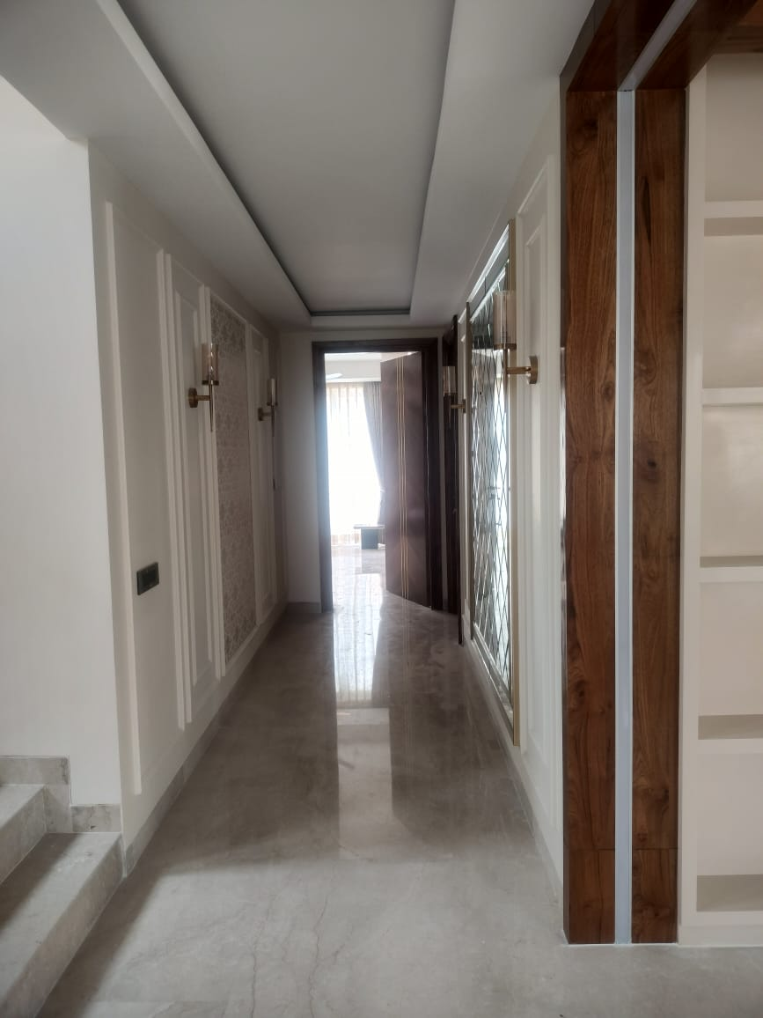


Mo:8375844698
CONTACTUS
You can always count on Aero Heat And Cool Solutions Pvt.Ltd Projects to get to you fast and get the job done right the first time.
Registered office:207,2nd Floor,Vashisht Complex,Metro Pillar No-51 ,Sikanderpur Market,Gurugram Haryana 122002
Mob:8375844698,9650959318
Tel.No-0124-4249153
E-mail : admin@aeroheatandcoolsolutions.in
www. aeroheatandcoolsolutions.in

